Slide 1

Agile 3-DB Systel
Neeraj Vohra

Slide 2
Engineering Practices for Agile?
Once you adopt Agile, take a next step to improve Engineering Practices by adopting eXtream Programming Practices, align to Lean principles this will truly lead towards Digital Agile Transformation.
Pair Programming (XP)
TDD/Unit Testing
Continuous Integration
Refactoring
Acceptance Testing
Small release
Emergent Design (OOPS principals SOLID)
Time-Boxing
Agile should not be viewed just as a project management technique or a SDLC Methodology, but also as a collection of best practices that should essentially touch every aspect of the development lifecycle. This will result in Optimized Agile Development.

Slide 3
Engineering Practices for Agile?
Business Analysis in Agile is transformed well by replacing SRS / BRD with Product Backlog.
Similarly, testing is also considered an integral part of the daily development activity in Agile.
Ever wondered about Design and Coding? There are a few discussions around Agile Architecture, Technical Debt, Test Driven Development, Behavioural Driven Development, but what are the guidelines which developers need to follow while writing the code?
Coding Standards
Emergent Design (SOLID Principle)
Don't reinvent the wheel:
Before you begin writing any new piece of code, check the Knowledge Repository, a predefined functionality is available in the Framework and API.

Slide 4
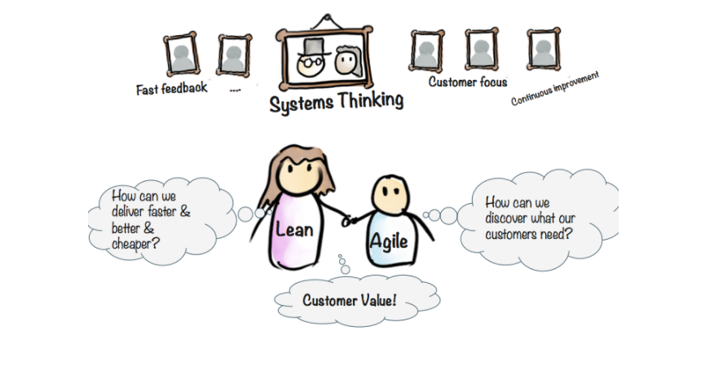
Lean & Agile are Siblings
The Lean methodology relies on 3 very simple ideas:
deliver value from your customer’s perspective
eliminate waste (things that don’t bring value to the end product)
continuous improvement

Slide 5
Lean
The Lean methodology is about continuously improving work processes, purposes, and people.
Purpose: What the customer problems
Process: How will the Organization access each major value stream to make sure each step is valuable, capable, available, adequate, flexible and that all steps are linked by flow, pull and levelling.
People: How can the organization ensure that every important process has someone responsible for continually evaluating that value stream in terms of business purpose and lean process? How can everyone touching the value stream by actively engaged it correctly continually improving it.
Instead of holding total control of work processes and keeping the spotlight, Lean management encourages shared responsibility and shared leadership.
The two main pillars of the Lean methodology are:
Respect of People
Continuous improvements

Slide 6
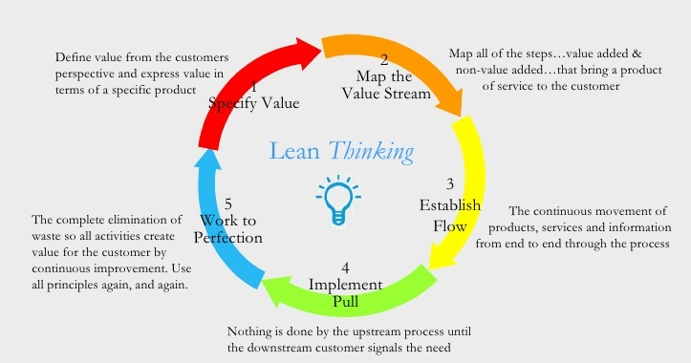
Lean Principles (How to create a Lean System)

Slide 7
Lean Principles (How to create a Lean System)
Identify Value: What does every company strive to do? To offer a product/service that a customer is ready to pay for. To do so a company needs to add value defined by its customer needs.
The value lies in the problem you are trying to solve for the customer. More specifically, in the part of the solution that your customer is actively willing to pay. Any other activity or process that doesn’t bring value to the end product is considered waste.
So you first need to Identify the value you want to deliver and then proceed to the next step.
Value Stream Mapping: This is the point where you literally need to map the workflow of your company . It has to include all the actions and people involved in delivering the end product to the customer. By doing so, you will be able to identify what parts of the process bring no value.
Applying the Lean principle of value stream mapping will show you where the value is being generated and in what proportion different parts of the process do or do not produce value.
When you have your value stream mapped, It will be much easier to you see which processes are owned by what teams and who is responsible for measuring , evaluating and improving that process. This big-picture will enable you to detect the steps that don’t bring value and eliminate them.

Slide 8
Lean Principles (How to create a Lean System)
Create Continuous Workflow: After you mastered your value stream, you need to sure that each team’s workflow remains smooth. Keep in mind that it may take a while.
Developing a product/service will often include cross-functional teamwork. Bottlenecks and interruptions may appear at any time. However, by breaking up work into smaller batches and visualizing the workflow, you can easily detect and remove process roadblocks.
Create a Pull System: Having a stable workflow guarantees that your teams can deliver work tasks much faster with less effort. However, in order to secure a stable workflow, make sure to create a pull system when it comes to the Lean methodology.
In such a system, the work is pulled only if there is a demand for it. This lets you optimize resources’ capacity and deliver products/services only if there is an actual need.
Let’s take a restaurant, for example. You go there and order a pizza. The baker pulls your order and starts making your pizza. He doesn’t prepare tons of dishes in advance because there isn’t actual demand, and these tons of dishes can turn into a waste of resources.

Slide 9
Lean Principles (How to create a Lean System)
Continues Improvement: Remember, your system is not isolated and static. Problems may occur at any of the previous steps. This is why you need to make sure that employees on every level are involved in continuously improving the process.
There are different techniques to encourage continuous improvement. For example, every team may have a daily stand up meeting to discuss what has been done, what needs to be done, and possible obstacles—an easy way to process improvements daily.
Benefits of Lean Management
The growing popularity of the Lean principles comes from the fact that they actually focus on improving every aspect of a work process and involve all levels of a company’s hierarchy.
There are a few major advantages that managers can benefit from.
Focus. By applying the Lean methodology, you will be able to reduce waste activities. Therefore, your workforce will be focused on activities that bring value.
Improving productivity & efficiency. When employees are focused on delivering value, they will be more productive and efficient because they won’t be distracted by unclear tasks.

Slide 10
Lean Principles (How to create a Lean System)
Smarter process (pull system). By establishing a pull system, you will able to deliver work only if there is actual demand. This leads to the next one.
Better use of resources. When your production is based on actual demand, you will be able to use only as many resources as needed.
As a result, your company (team) will be much more flexible and able to respond to consumers' requirements much faster. In the end, Lean management principles will let you create a stable production system (Lean system) with a higher chance of improving overall performance.
Lean management is more like a guide for building a stable organization that evolves constantly and helps to identify actual problems and remove them.
The main purpose of Lean management is creating value to the customer by optimizing resources.
Lean management principles aims to create a stable workflow based on actual customer’s demand.
Continuous improvement is a major part of Lean management, ensuring that every employee is involved in the process of improving.

Slide 11
The Customer Defines Value In Lean
It supports organizations in many aspects like reducing costs, optimizing processes, improving quality, etc. However, what really makes Lean effective is the focus on value.
In terms of Lean, the value should always be considered from a customer perspective. At the end of the day, it doesn’t matter whether you came up with a great idea if the customer doesn’t see any value, and therefore she is not ready to pay for it.
Value is everything that your customer is willing to pay for
It is important to remember that customers enjoy value in its entirety but not delivered piece by piece. It is tricky, but you may end up with a bunch of unhappy customers and low brand equity if you ignore this.
Here is an example. Imagine that you buy a laptop. You had your laptop delivered, and when you try to run it, you realize that the machine is without an operating system.

Slide 12
Waste in Lean DOWNTIME
Waste | Software Dev
Defects | Bugs
Overproduction | Features nobody uses
Waiting | Wasted time waiting for the next step of the process.
Non-Utilized Talent | UnderUtilizing people's talents, skills and Knowledge
Transport | Task switching, interruptions
Inventory | Undelivered code. Undelivered features
Motion | Unnecessary meetings, extra effort to find information
Extra-processing | Unnecessary complex algorithms solving simple problems. More work or higher quality than is required by the customer

Slide 13
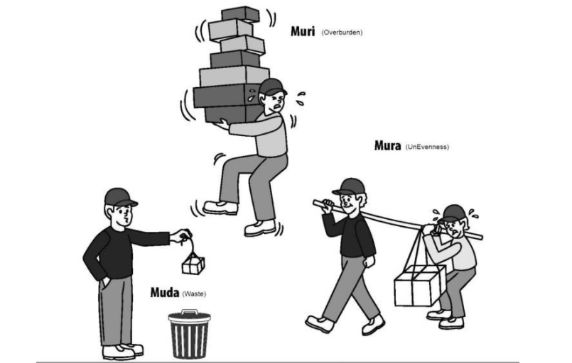
3M of Lean

Slide 14
3M of Lean
Muda (DOWNTIME). Wasteful activities, aim to reduce unnecessary work and improve efficiency.
Muda is the direct obstacle of flow. Simply taking out the muda does not work. Usually, there is a reason why the muda is there and this reason often has to do with the other two enemies: muri and mura. This means the three enemies of Lean are interrelated and should therefore be considered simultaneously.
Non-Value-Added Activity
Incurs Cost
Mura: unevenness of workflow, can be found in fluctuation in customer demand
Reduces Responsiveness
Leads to waste events.
Muri: overburden, can result from Mura, and from removing too much Muda (waste) from the process.
Reduces Responsiveness
Leads to waste events.

Slide 15
5S of Lean
5S is a system to reduce waste and optimize productivity through maintaining an orderly workplace and using visual cues to achieve more consistent operational results. Implementation of this method "cleans up" and organizes the workplace basically in its existing configuration, and it is typically the first lean method which organizations implement.
Sort (Seiri)
Separate required tools, materials, and instructions from those that are not needed. Remove everything that is not necessary from the work area.
Set in order (Seiton):
Sort and organize all tools, equipment, files, data, material, and resources for quick, easy location, and use. Label all storage locations, tools, and equipment.
Shine (Seiso):
Set standards for cleanliness. Clean and remove all trash, grease, and dirt. Cleanliness provides a safe workplace and makes potential problems noticeable (e.g., equipment leaks, loose parts, loose paperwork, or materials).

Slide 16
5S of Lean
Standardize (Seiketsu)
Engage the workforce to systematically perform steps 1, 2, and 3 above daily to maintain the workplace in perfect condition as a standard process. Establish schedules and set expectations for adherence.
Sustain (Shitsuke)
Build organizational commitment so that 5S becomes one of your organizational values so that everyone can turn it into a habit.
How to Apply 5S in Project Management/Knowledge Work?
When your workplace is an office, and your team does most of their work on a computer, 5S may seem inapplicable or not worth the effort. However, it is the exact opposite as organizing knowledge work is much harder than organizing your workspace.
Sorting software tools
Typically, the primary tools your team utilizes in a typical knowledge-work scenario are software solutions. This way, you can save both money and virtual space on unnecessary software.

Slide 17
5S of Lean
Setting order
After you’ve organized your software solutions and have kept only those that bring value, try to scale their effect.
Setting order is crucial, especially when it comes to documents, as they can be lost easily. If you are among the majority of companies that rely on cloud storage (e.g., Google Drive, Onedrive), make sure that your folders are organized and labeled clearly.
Shine
Make sure to keep your software solutions updated and educate yourself and your team on how to make the most of any new feature that the software provider releases.
Standardize
Therefore, you should standardize how each team works and visualize the process so that everybody understands it. A simple way to do so is to map every step of your workflow on a digital Kanban board and agree with your employees to place every task they are processing there.
Sustain
Lean management relies heavily on shared leadership, so be sure to listen to your employees and give them the liberty to suggest changes to achieve continuous improvement. Establish feedback loops and encourage your team to look for ways to improve your process further.

Slide 18
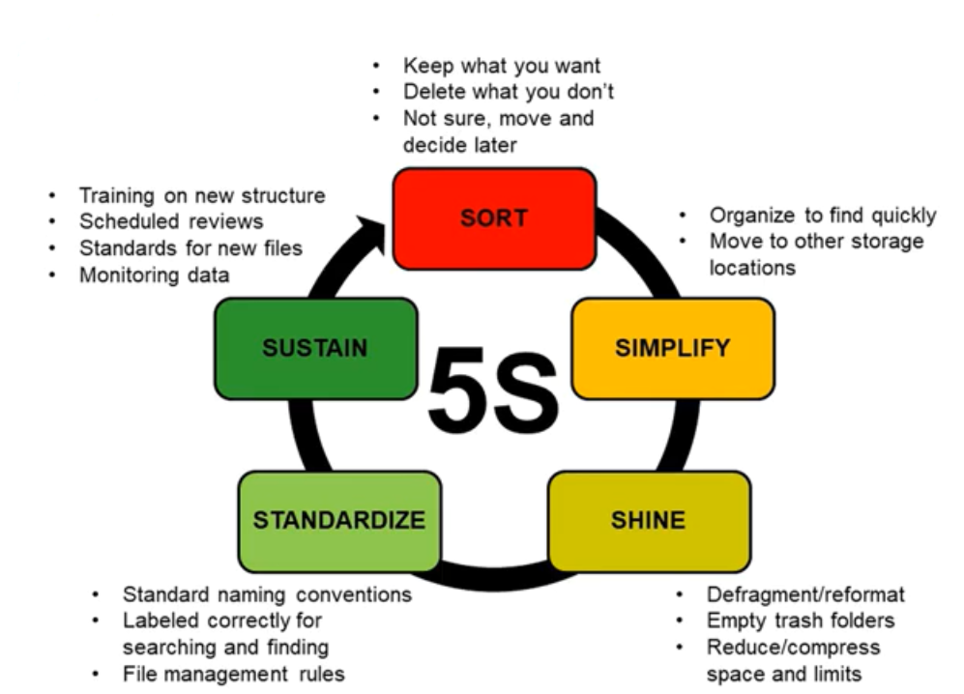
5S of Lean

Slide 19
Cost of Delay
Cost of delay (CoD) is a key metric in lean management that represents the economic impact of a delay in project delivery.
Examples of Cost of Delay
The most basic explanation that you’ll find is that CoD is the economic impact of a delay in project delivery.
This can be placed in various contexts like:
Product development – the amount of money you will lose if you delay your new product's launch.
Software development – the amount of money you will lose if you delay the release of a groundbreaking feature that will give you an advantage over the competition.
IT Operations – the amount of money you will lose if you fail to deliver the strategic initiative that the CEO wants.
CoD combines urgency and value – two things that humans are not very good at distinguishing between. To make decisions, you need to understand not just how valuable something is but how urgent it is.

Slide 20
How to Calculate Cost of Delay?
To calculate the potential costs of delay, you need to anticipate the revenue that you will earn per week after you deliver anything to the market.
For example, if you are in a SaaS company and plan to deliver a new add-on feature that you anticipate will bring you $20 000 per week, every week you postpone the release will cost your company this sum.

Slide 21
What is a Pull System?
A pull system is a Lean technique for reducing the waste of any production process. Applying a pull system allows you to start new work only when there is customer demand for it. This allows you to reduce overhead and optimize storage costs.
Why Is Pull Better Than Push?
The purpose of implementing a pull system is to build products based on actual demand and not on forecasts. By doing so, your company can focus on eliminating waste activities in the production process. As a result, you’ll be able to optimize your resources and reduce the possibility of overstocking.
Furthermore, applying a pull system will allow you to deliver work just in time.
“Just-in-time” is a production model where deliverables are produced in order to meet actual demands and avoid overstocking and push strategies.
When applying a push strategy, a company’s production is based on anticipated demand, which can fail to correspond with the actual demand. Such an imbalance can create unexpected financial gaps.

Slide 22
What is a Pull System?
In knowledge work, the “just-in-time” concept can be applied in the same way as in manufacturing – a work item has to be in progress only if there is a demand for it.
This is the opposite of “Just in Case”, where companies somehow try to ensure themselves by overproducing in case of higher demands somewhere in the future.
Advantages of Using a Pull System
Unlike push systems, which force team members to work on multiple tasks, a pull system lets team members focus on a single work item at a time. This approach allows a work unit to:
Quickly adapt to changes that may occur in the work process
Scale the optimal capacity of your team
Deliver work items much faster
Reduce waste of resources
Increase productivity
Improve flow efficiency
Actually, by using lean pull principles, you can be much more predictable when planning your future work. How is this possible?
Pull systems allow you to collect historical data about your workflow and the average cycle time of tasks.

Slide 23
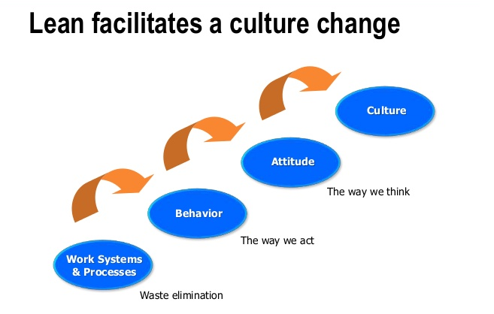
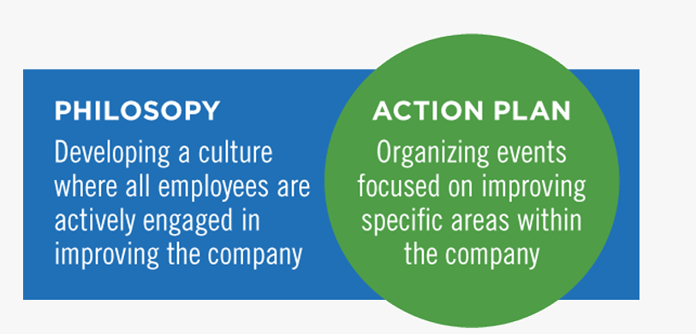
Lean facilitates a culture change

Slide 24
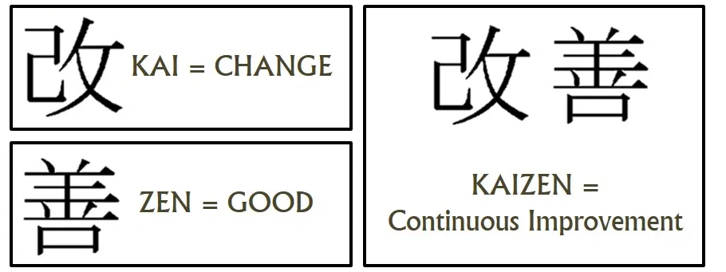
Kaizen (Continuous Improvement)
Kaizen’s goal is to enact a series of small, continuous improvements over time. These changes cumulatively add up to large improvements overall. And it does this by making everyone in the organization a stakeholder whose ideas and in puts are valued. This improves the culture and business performance of the company.

Slide 25
Kaizen Requirement
As a strict and methodical endeavor, it can’t be undertaken by a single department nor can it be driven by a single individual. Instead, kaizen needs a commitment to implementation. For this to happen, certain conditions or requirements are needed for the methodology to succeed.
Executive and Corporate Commitment – No methodology can succeed without a commitment form its leaders. The company must set aside time for both management and employees to participate at the comprehensive level required to succeed.
Dedication – Kaizen must be presented as a business strategy that will improve the bottom line and make conditions better at all job levels. This buy-in among line employees and managers is just as important as executive buy-in. It helps those at all levels understand its benefits and allows them to develop an attitude conducive to success.
Openness to Change – Change is hard in any company. And the kind of cultural change brought about by a continuous improvement methodology can be especially daunting. By constantly monitoring job duties and encouraging the right kind of employee interaction and interdepartmental communication, kaizen has a better chance to work.
A ‘No-Fault’ Approach – Kaizen requires that both group and individual performance be questioned. This does not mean finger pointing or blame. It simply means that employees are freed to discuss barriers and challenges that they have all witnessed as present in the past and gives them a forum and a method to work on a resolution.

Slide 26
Benefits of Kaizen Methodology
Once a company has decided on kaizen as a path to continuous improvement and has met the threshold for requirements that will allow it to succeed, there are many benefits to be found. These benefits include:
Culture of Continuous Improvement – Perhaps no benefit is greater than the creation of a culture of continuous improvement. By empowering employees to make the changes that drive incremental improvement, a culture of value and of knowing that individual opinions matter. These include real changes and not just suggestions that go nowhere. True deployment of kaizen methodology gives employees power to stop a production process and work as part of a team to find the root cause of a problem and develop a qualitative solution. This feeling that everyone has a place and a voice and that everyone is a stakeholder can transform a culture into one of solid and well-functioning teams.
Stronger Teams – By building on the idea of teamwork rather than individualism, an atmosphere is created whereby everyone feels tied to the rewards and benefits of the improvement. This creates a fully engaged staff who are more motivated and more confident in their everyday jobs because they know that they are part of a group working toward the same goals – improving the process. Teams are constantly working to improve as part of their daily work rather than team building done as a yearly or twice yearly ‘exercise’ by HR. Staff members feel freer to communicate and the team becomes part of their ‘internal DNA’ – making teamwork ongoing rather than episodic.
.

Slide 27
Benefits of Kaizen Methodology
Improved Productivity – Lean methodologies always focus on waste. And waste is identified as anything that does not add value for the customer. This may include collecting useless data, unnecessary movement due to inefficient tool and equipment setup, idle time created by staging, WIP and caterpillar effect upstream processes and others. By identifying root cause and by crafting a solution that eliminates these and other forms of waste, productivity is increased, and the process of ‘work’ only includes those value steps that benefit the customer.
Reduced Defects and Improved Quality – A high level of defects points to the likelihood of broken processes. Because rework is costly in terms of labor, material and missed deliveries, kaizen can work towards an environment of getting it right the first time. Kaizen can build in problem solving and techniques that help identify root causes to problems. Once this is identified, the process can be changed to eliminate the cause of errors.
Improved Competitive Advantage – With higher productivity, fewer defects and ongoing continued improvement, a company’s competitive advantage will improve. This also has a multiplier effect because as the staff become more skilled in teamwork and application of kaizen methodology, they become more skilled at their jobs overall. The process of continued improvement does not end after the achievement of goals. Rather, it is ‘re-invested’ in the team who now move forward with sharpening and honing processes even further and in innovating new processes as they go. These benefits cumulatively improve a company’s competitive advantage..

Slide 28
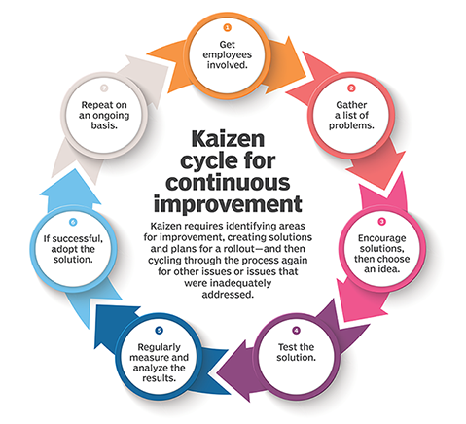
Kaizen Cycle for Continuous Improvement

Slide 29
Kaizen Cycle for Continuous Improvement
Get employees involved. Seek the involvement of employees, including gathering their help in identifying issues and problems. Doing so creates buy-in for change. Often, this is organized as specific groups of individuals charged with gathering and relaying information from a wider group of employees.
Find problems. Using widespread feedback from all employees, gather a list of problems and potential opportunities. Create a list if there are many issues.
Create a solution. Encourage employees to offer creative solutions, with all manner of ideas encouraged. Pick a winning solution or solutions from the ideas presented.
Test the solution. Implement the winning solution chosen above, with everyone participating in the rollout. Create pilot programs or take other small steps to test out the solution.
Analyze the results. At various intervals, check progress, with specific plans for who will be the point of contact and how best to keep ground-level workers engaged. Determine how successful the change has been.
Standardize. If results are positive, adopt the solution throughout the organization.
Repeat. These seven steps should be repeated on an ongoing basis, with new solutions tested where appropriate or new lists of problems tackled.

Slide 30
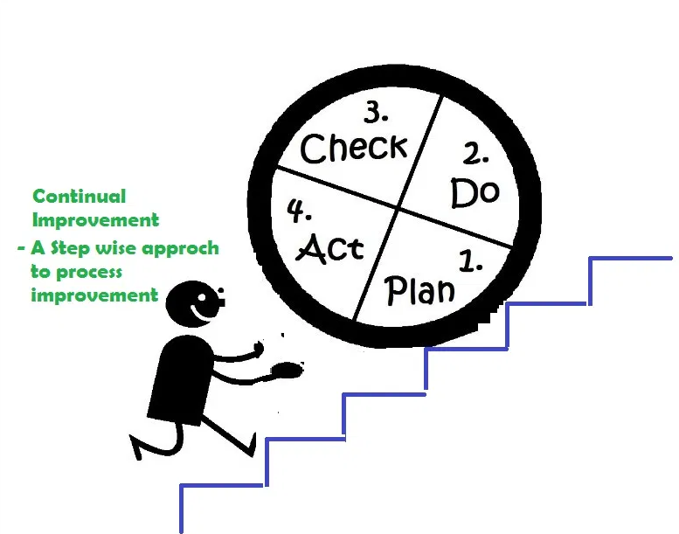
Kaizen Cycle for Continuous Improvement
KAIZEN- change for better (Learning is Continuous journey not the destination) through Retrospective
• Continuous Improvement
• Everyone is equally important for success,
• Members are confident about offering suggestions

Slide 31

Kanban
A kanban board is an agile project management tool designed to help visualize work, limit work-in-progress, and maximize efficiency (or flow). It can help both agile and DevOps teams establish order in their daily work. Kanban boards use cards, columns, and continuous improvement to help technology and service teams commit to the right amount of work, and get it done!
Kanban, is a lean software development methodology for managing the creation of products that focuses on just-in-time delivery of functionality and managing the amount of work in progress (WIP). Making checklists is simple. It keeps us focused on the next step and not the bigger picture.

Slide 32
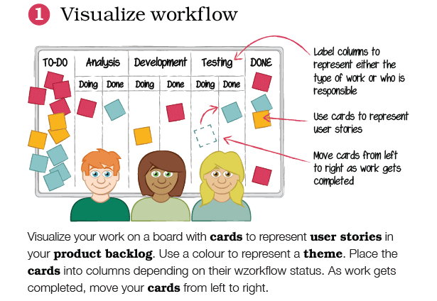
Kanban Principles-Visualize workflow

Slide 33
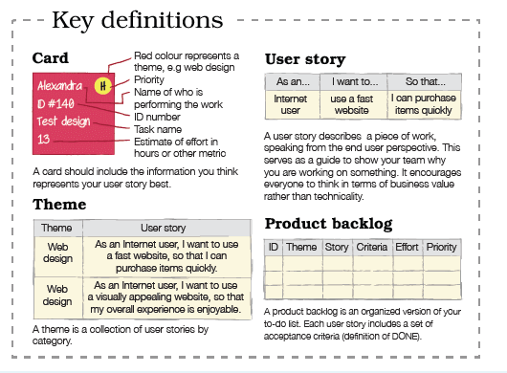
Kanban Principles-Visualize workflow

Slide 34
Kanban Principles-Visualize workflow
Visualize your work on a board with cards to represent user stories (work) in your product backlog (inventory). Use colours to represent the theme of your user stories. For a simple Kanban board, label one column “TO-DO” and another “DONE”. Label columns in between “TO-DO” and “DONE” to represent either the type of work or whoever is responsible for undertaking it. Split these columns into two and label “Doing” and “Done”. Place the cards into columns depending on their workflow status. Doing this enables the whole team to view work in progress, work that has been completed and work to be started next. As work gets completed, move your cards from left to right.
Top tip: Keep your column labels simple and intuitive.

Slide 35
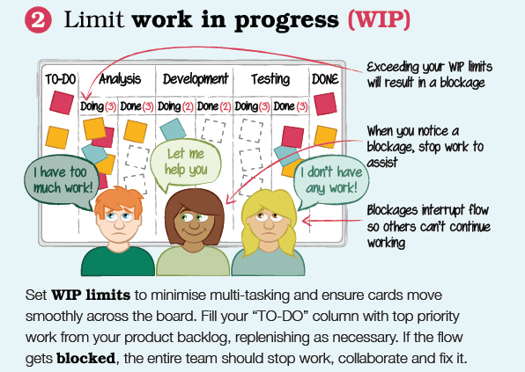
Kanban Principles- Limit work in progress (WIP)

Slide 36
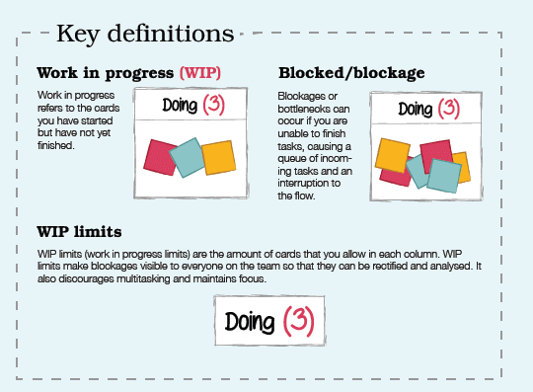
Kanban Principles- Limit work in progress (WIP)

Slide 37
Kanban Principles- Limit work in progress (WIP)
Set a limit on how much work can be in progress at one time in each column. In other words, how many cards can be in each column at a given time. This ensures that cards are moving smoothly across the board as and when the team are ready for them.
Do the top priority work first
Your “TO-DO” column should be filled with top priority work from your product backlog. When you have a space in your “TO-DO” column, you can fill it with another user story from your product backlog.
By setting work in progress limits (WIP limits), the entire team can quickly see if there is a blockage and collaborate to fix it. Setting WIP limits eliminates multi-tasking, which is the ultimate productivity killer.
Top tip: Teams can assist other teams when bottlenecks are identified, regardless of expertise.

Slide 38
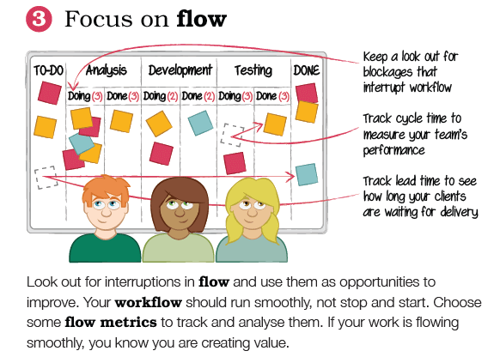
Kanban Principles- Focus on flow

Slide 39
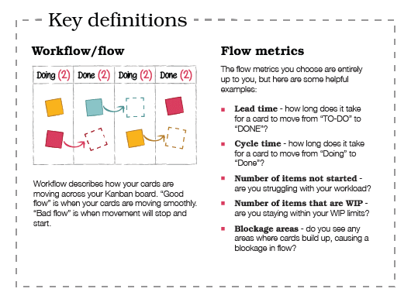
Kanban Principles- Focus on flow

Slide 40
Kanban Principles- Focus on flow
By now, your work should flow freely through the Kanban system. It might even feel very easy! Make sure that you keep a lookout for any interruptions in flow and use these as opportunities for improvement. Workflow should run smoothly and not stop and start. Choose some flow metrics to track and analyze them. Which ones you choose are entirely up to you, but here are some helpful examples:
Lead time - how long does it take for a card to move from “TO-DO” to “DONE”?
Cycle time - how long does it take for a card to move from “Doing” to “Done”?
Number of items not started - are you struggling with your workload?
Number of items that are WIP - are you staying within your WIP limits?
Blockage areas - do you see any areas where cards build up, causing a blockage in flow?
Top tip: Smooth flow = creating value

Slide 41
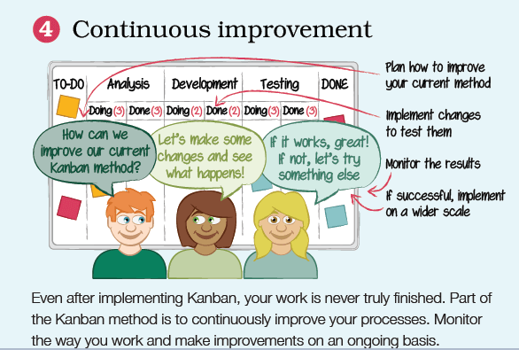
Kanban Principles- Continuous improvement
Remember that even after implementing Kanban, the work is never truly finished. Part of the Kanban method is to continuously improve your processes. Monitor your Kanban system and make improvements on an ongoing basis.

Slide 42
Extreme-Programming (XP)
Extreme programming (XP) is a software development methodology which is intended to improve software quality and responsiveness to changing customer requirements. As a type of agile software development, it advocates frequent "releases" in short development cycles, which is intended to improve productivity and introduce checkpoints at which new customer requirements can be adopted.
Other elements of extreme programming include programming in pairs or doing extensive code review, unit testing of all code, not programming features until they are actually needed, a flat management structure, code simplicity and clarity, expecting changes in the customer's requirements as time passes and the problem is better understood, and frequent communication with the customer and among programmers. As an example, code reviews are considered a beneficial practice; taken to the extreme, code can be reviewed continuously (i.e., the practice of pair programming).
Pair programming is a technique in which two programmer work as a team in which one programmer writes a code and other one reviews that code, they can switch their roles.

Slide 43
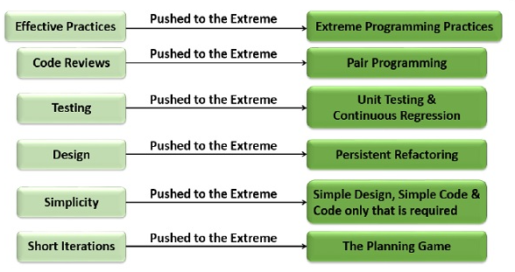
Why is it called “Extreme?”
Extreme Programming takes the effective principles and practices to extreme levels.
Code reviews are effective as the code is reviewed all the time.
Testing is effective as there is continuous regression and testing.
Design is effective as everybody needs to do refactoring daily.
Integration testing is important as integrate and test several times a day.
Short iterations are effective as the planning game for release planning and iteration planning.

Slide 44
Extreme Programming Advantages
Extreme Programming solves the following problems often faced in the software development projects −
Slipped schedules − Achievable development cycles ensure timely deliveries.
Cancelled projects − Focus on continuous customer involvement ensures transparency with the customer and immediate resolution of any issues.
Costs incurred in changes − Extensive and ongoing testing makes sure the changes do not break the existing functionality. A running working system always ensures sufficient time for accommodating changes such that the current operations are not affected.
Production and post-delivery defects: Emphasis is on − the unit tests to detect and fix the defects early.
Misunderstanding the business and/or domain − Making the customer a part of the team ensures constant communication and clarifications.
Business changes − Changes are considered to be inevitable and are accommodated at any point of time.
Staff turnover − Intensive team collaboration ensures enthusiasm and good will. Cohesion of multi-disciplines fosters the team spirit.
Improves the quality- As second partner review the code simultaneously, it reduces the chance of mistake.
Knowledge Transfer -One experience partner can teach other partner about technology and functionality.

Slide 45
Thank You

